Slide 1
HMM output

Slide 2
Jasper Ridge

Slide 3
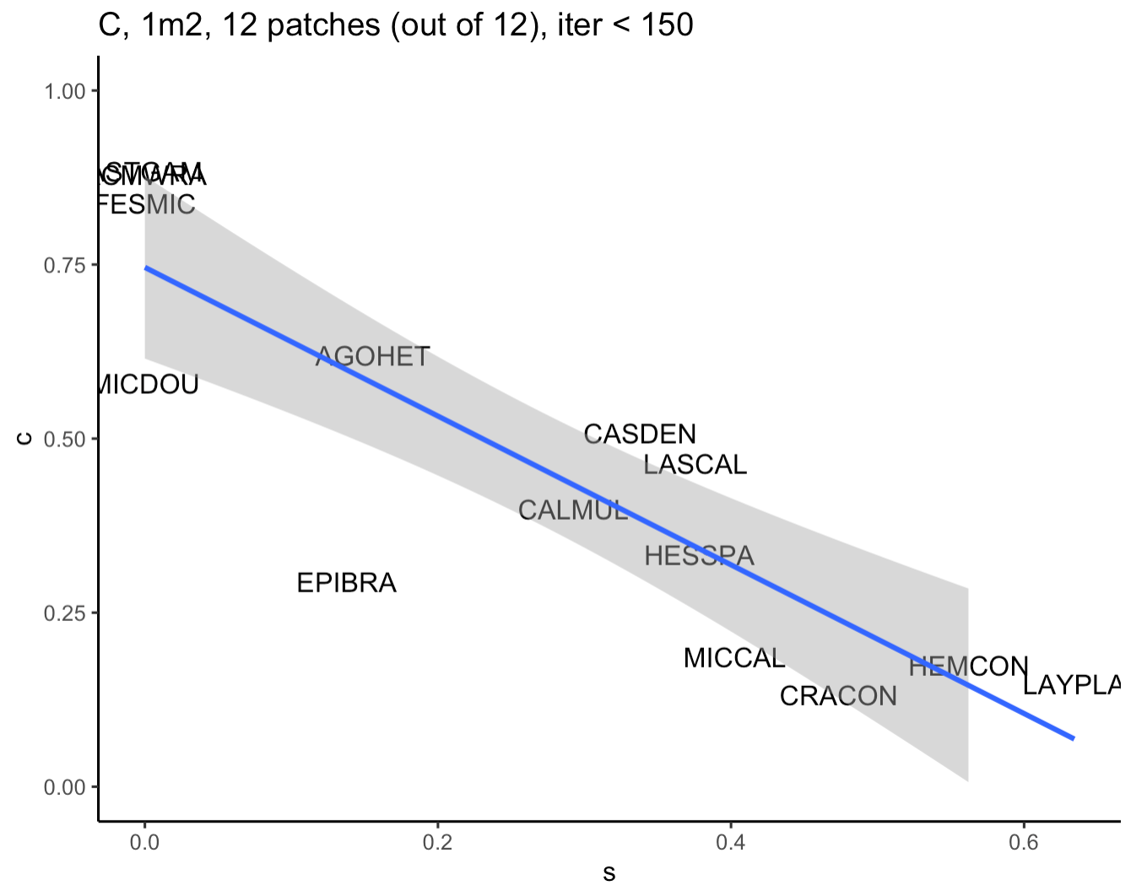
Note that ASTGAM switches from colonizer to disperser
Upper right
ASTGAM
ACMWRA

Slide 4
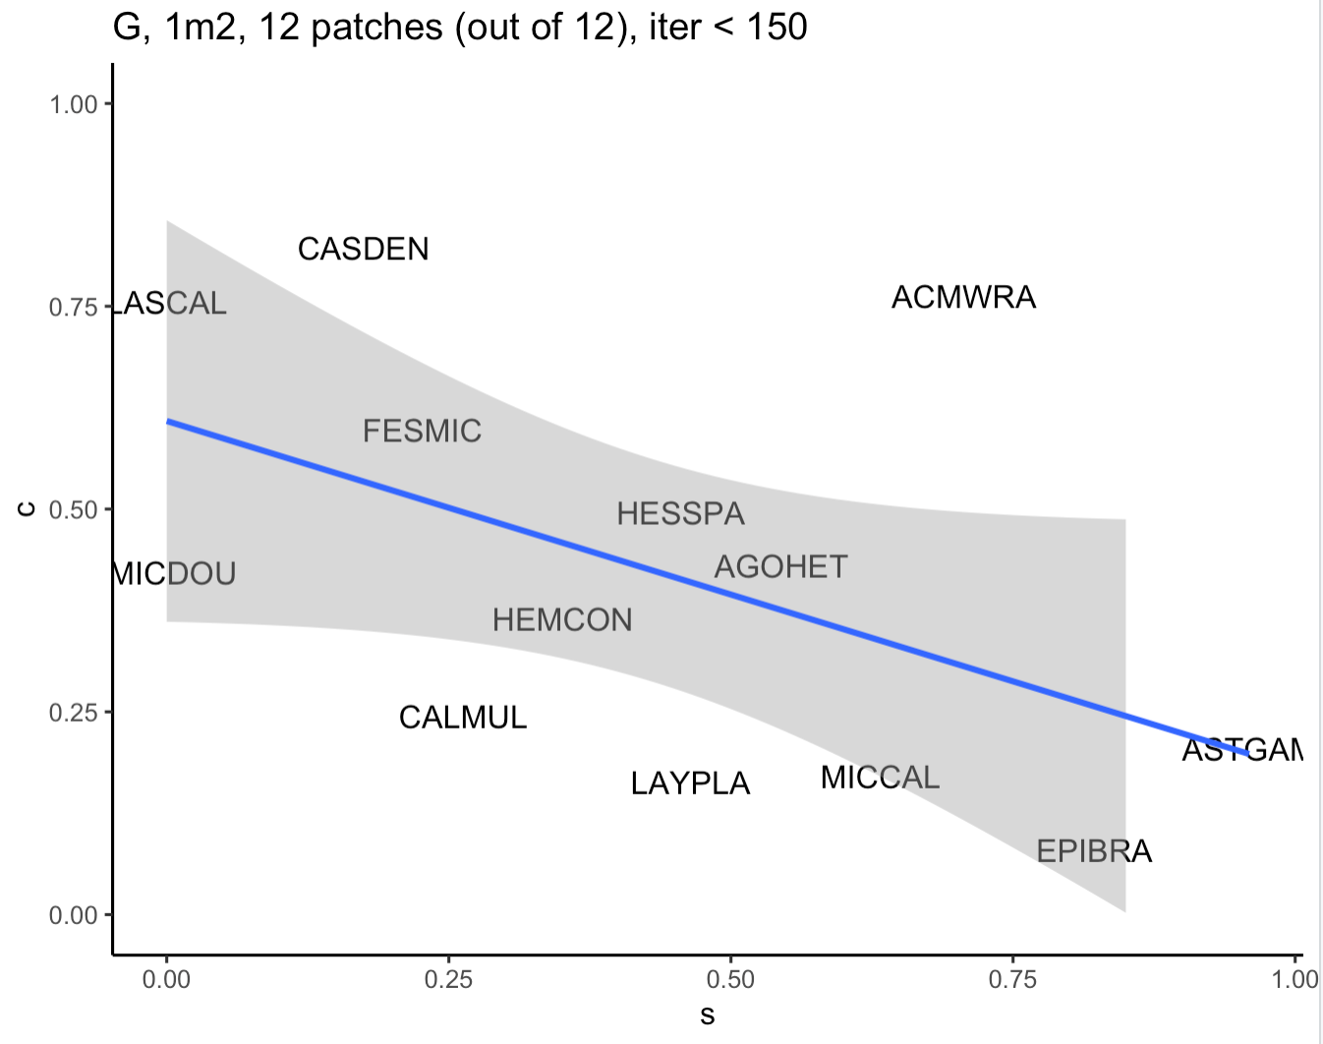

Slide 5
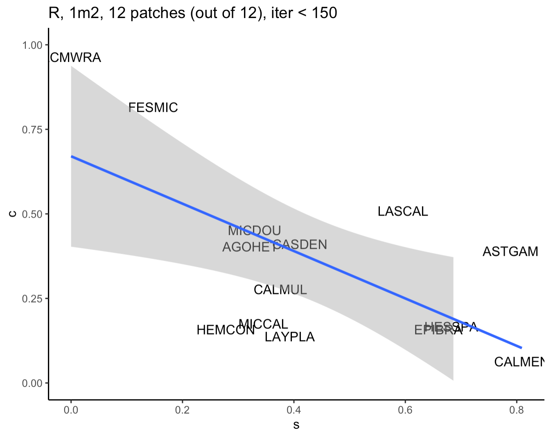

Slide 6
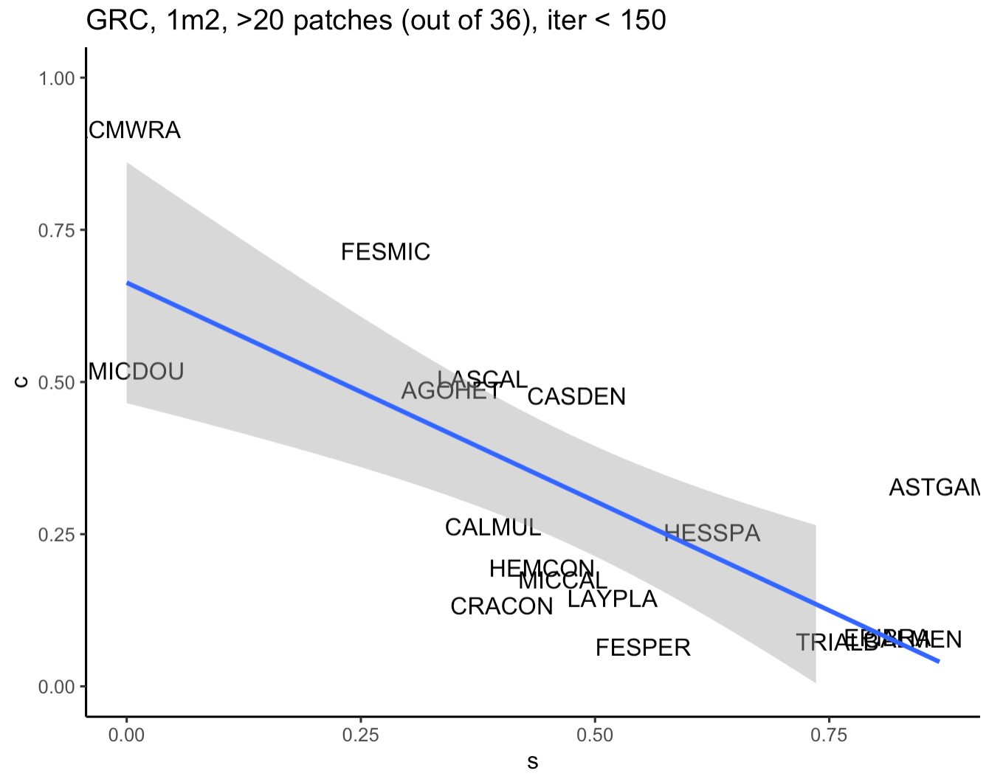
Note that ASTGAM switches from colonizer to disperser
Bottom right:
TRIALB
EPIBRA
CALMEN

Slide 7
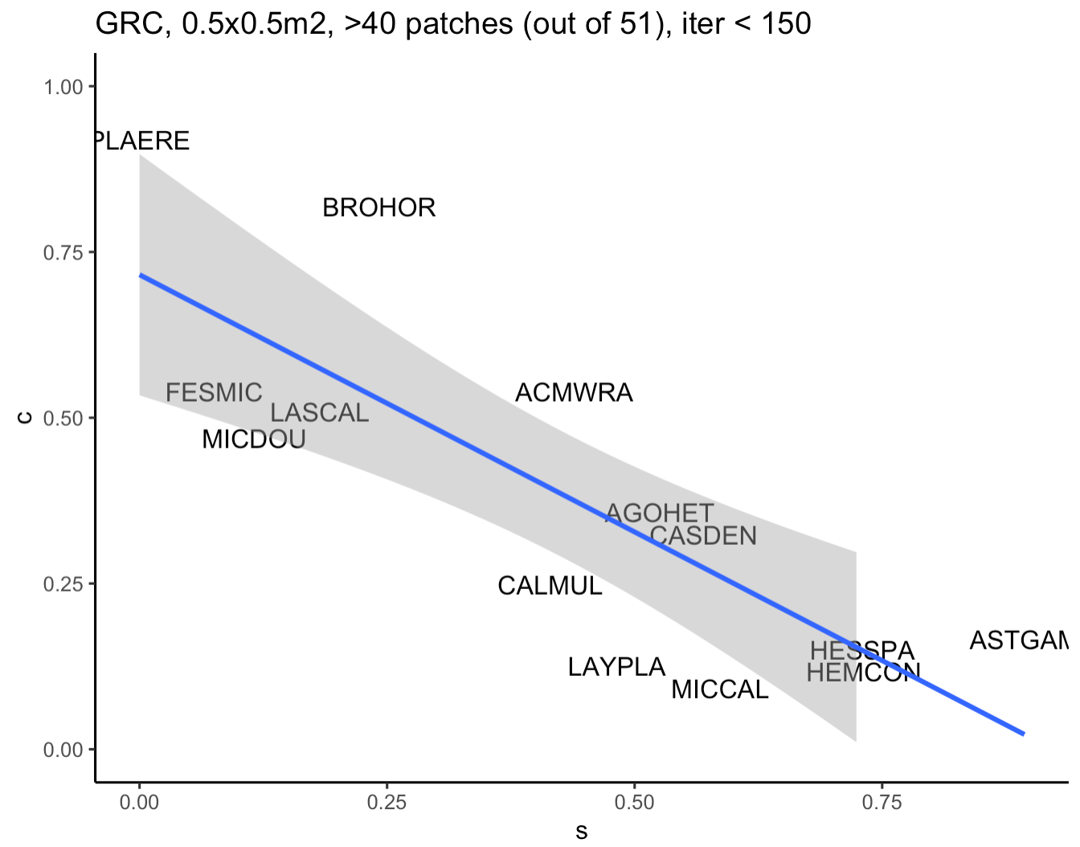
*out of 54

Slide 8
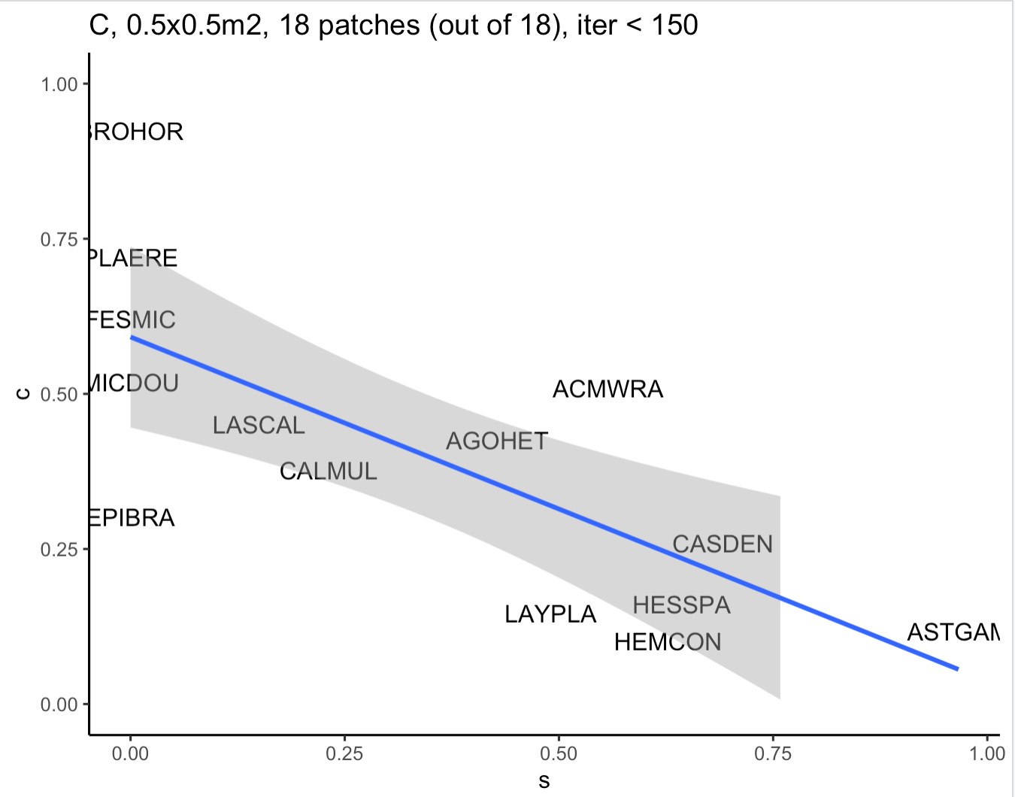
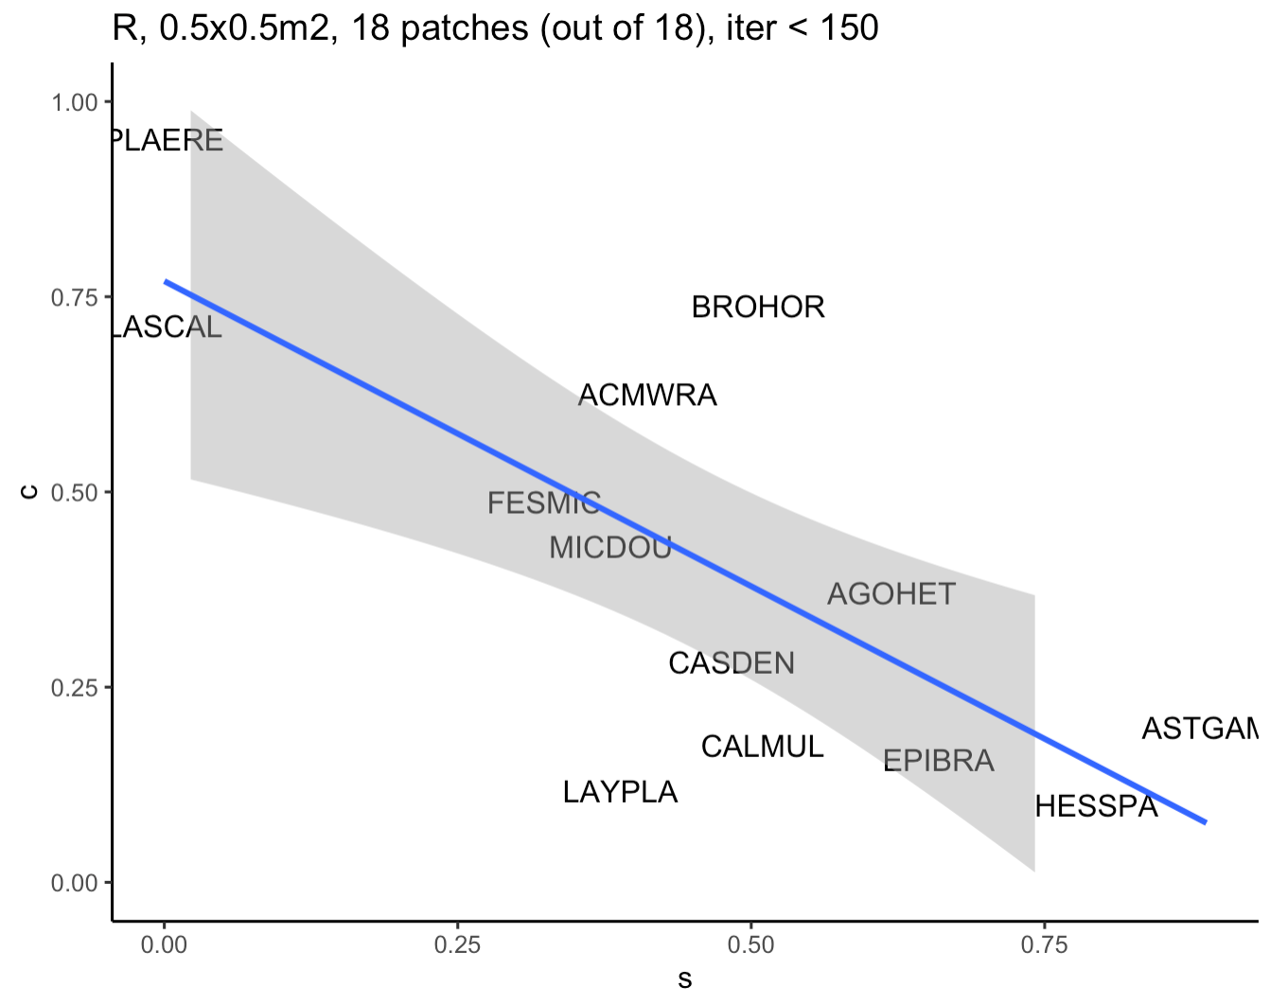
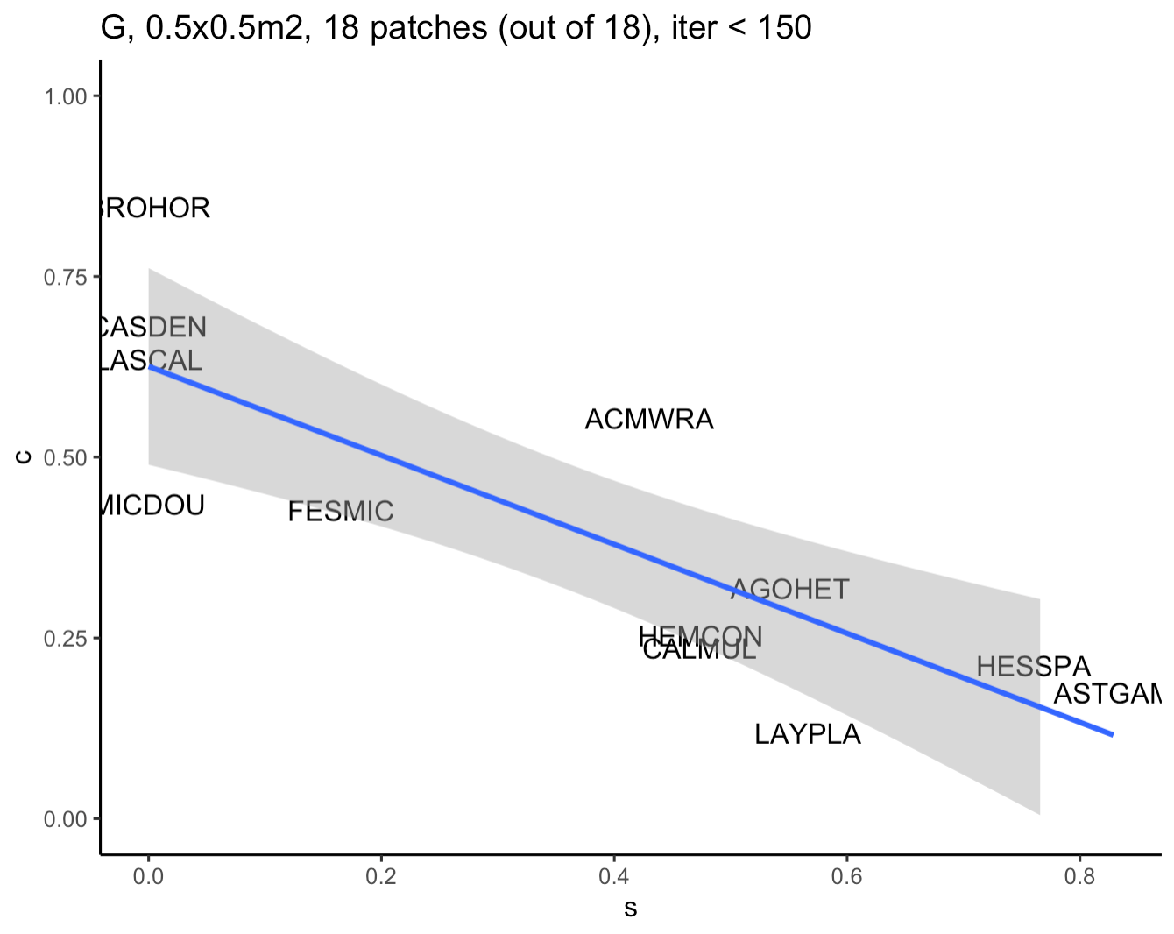

Slide 9
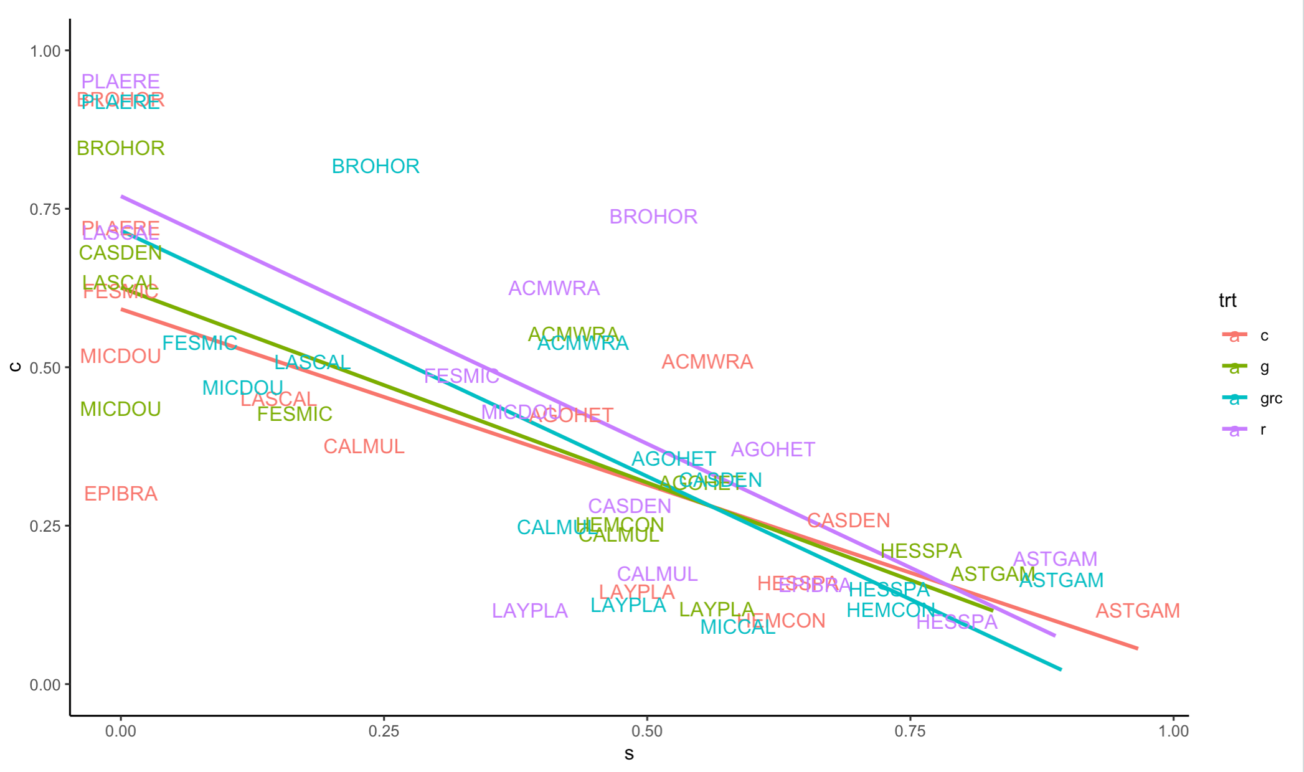
0.5m plots, based on ind graphs in prev slides

Slide 10
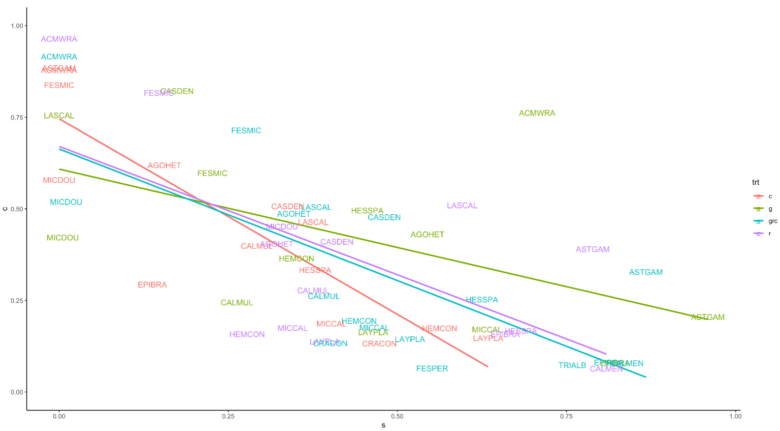
1m plots

Slide 11
Sonoran Desert

Slide 12
Carrizo Plain

Slide 13
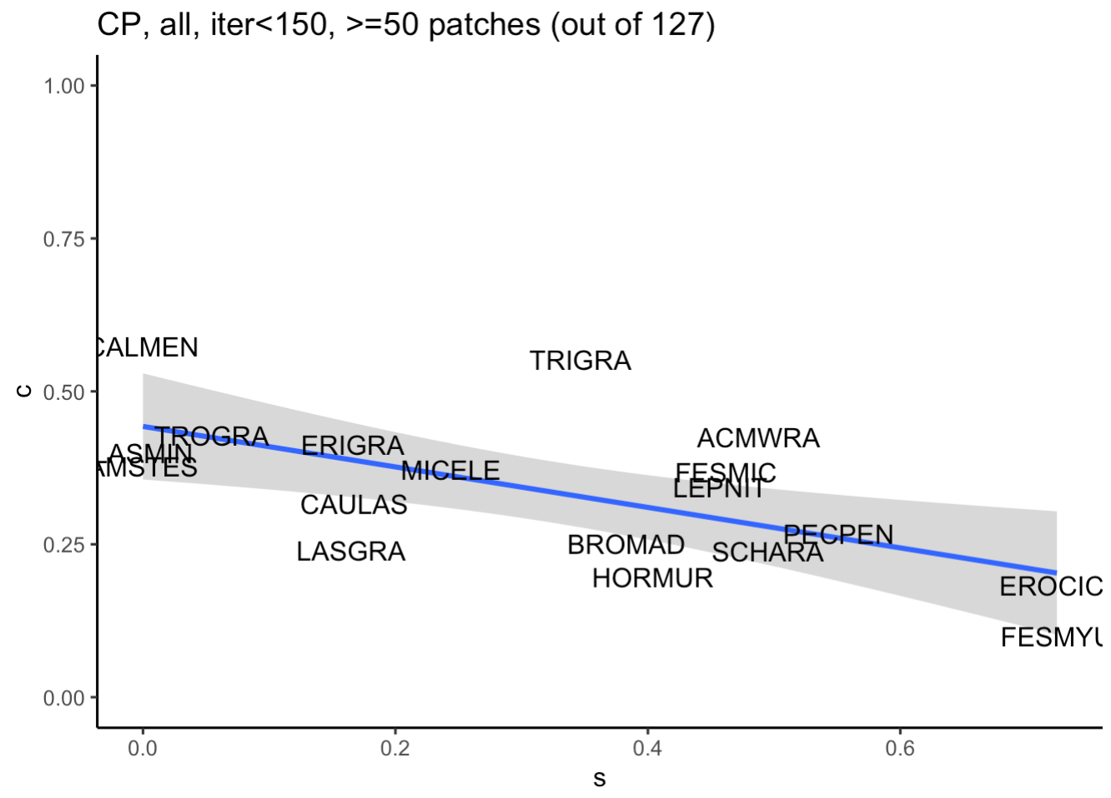
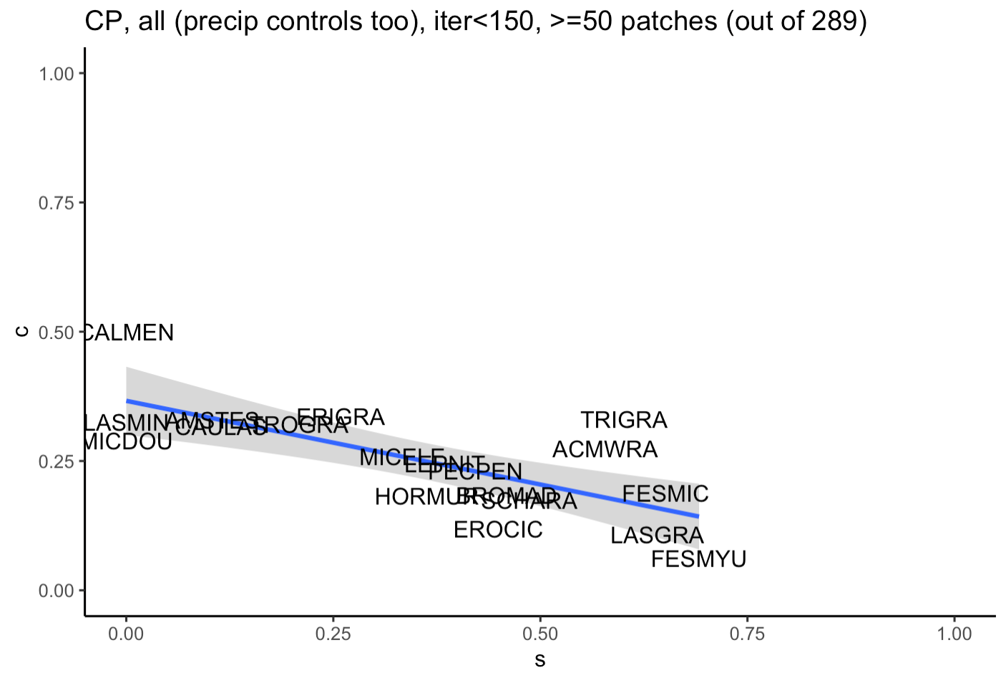

Slide 14
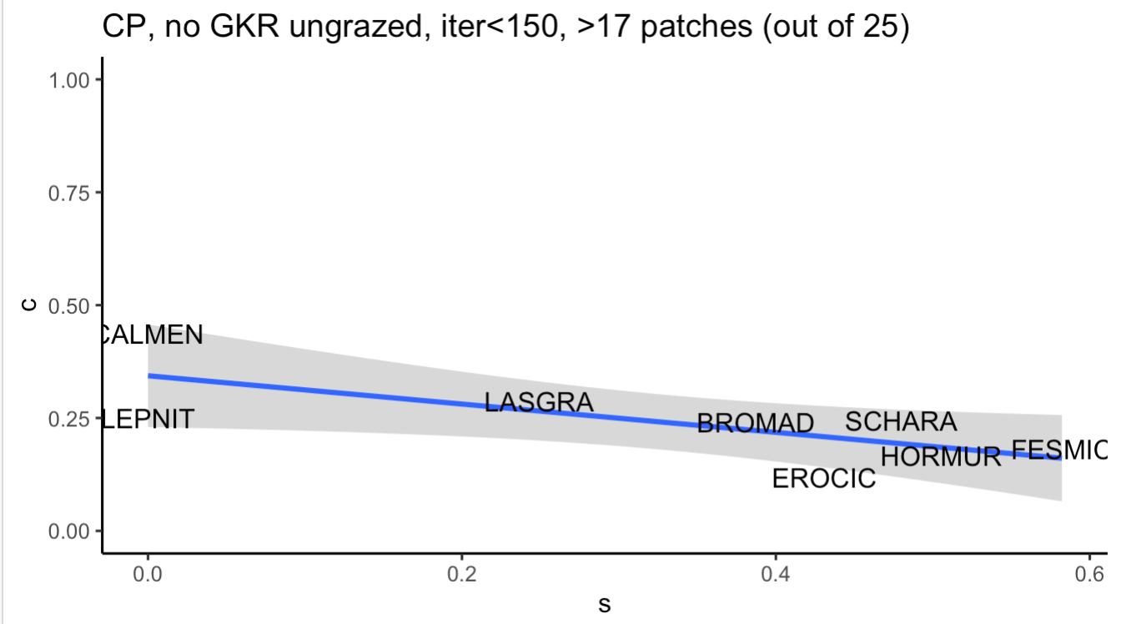
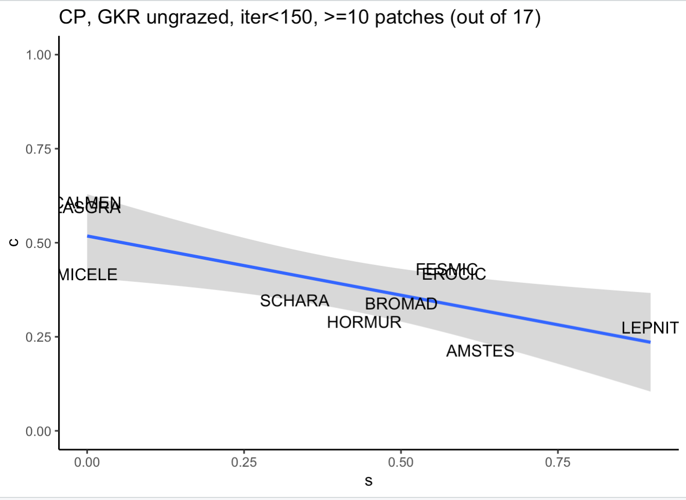
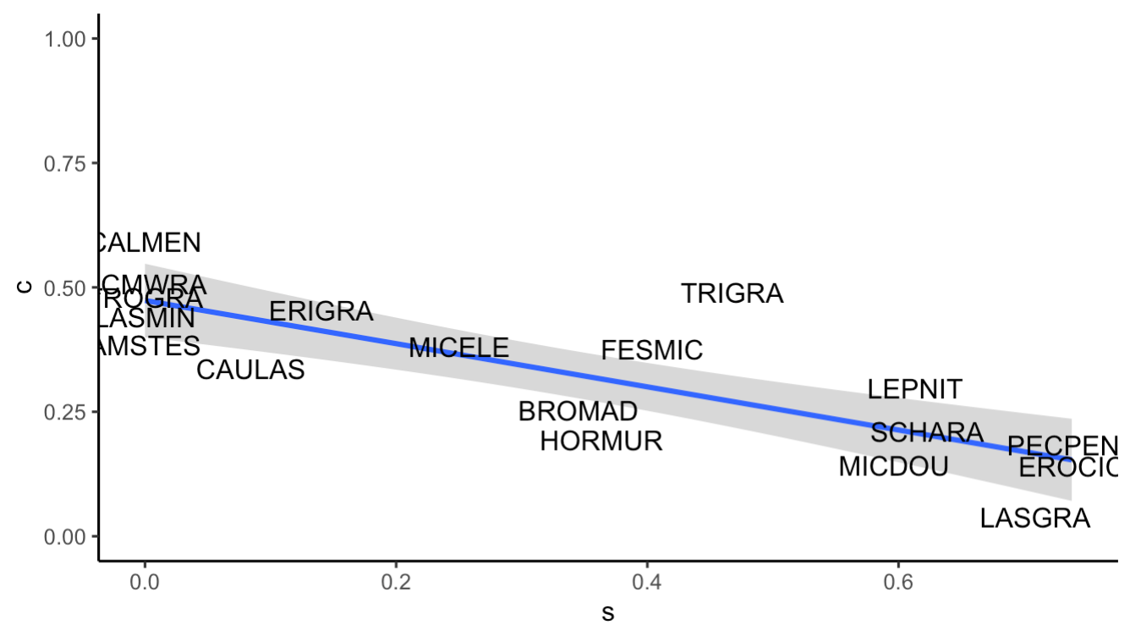
GKR present, grazed, iter <150, >40 patches out of 93 patches

Slide 15
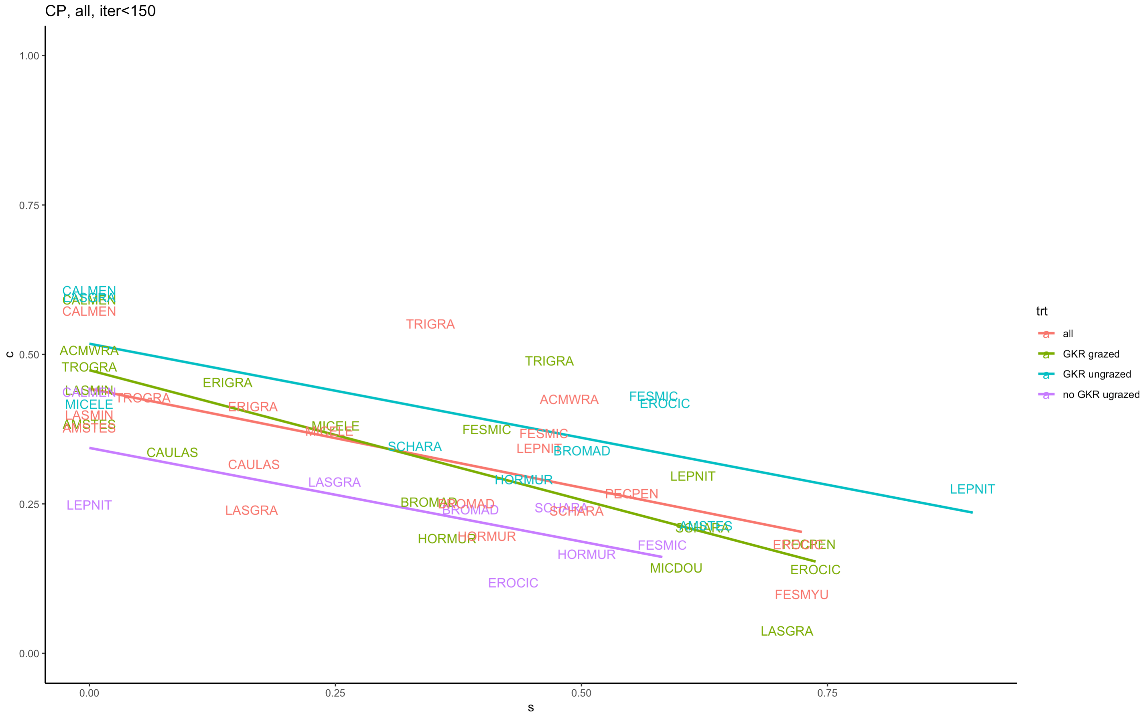
Notes:
Zero estimated species are dominant species,

Slide 16
Portal, Arizona

Slide 17
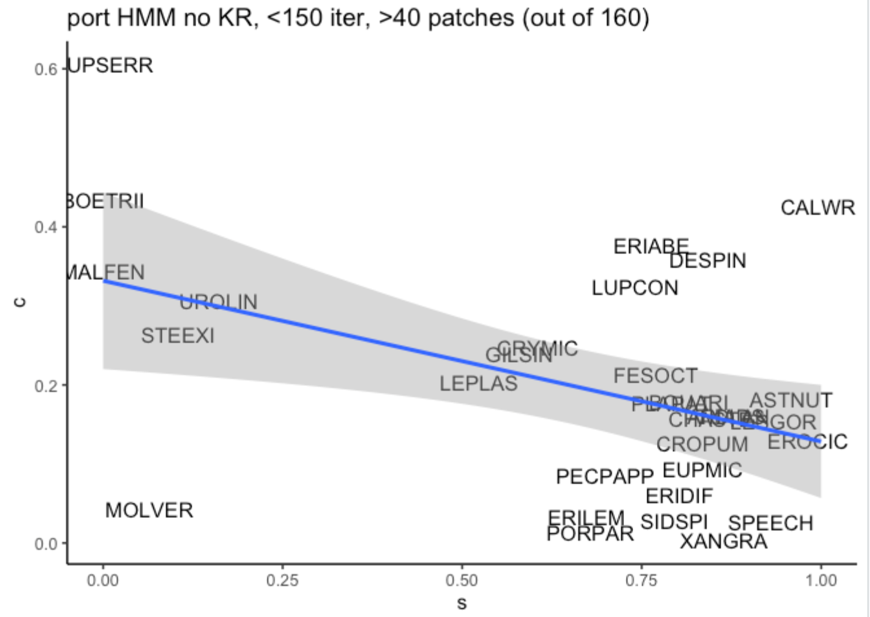
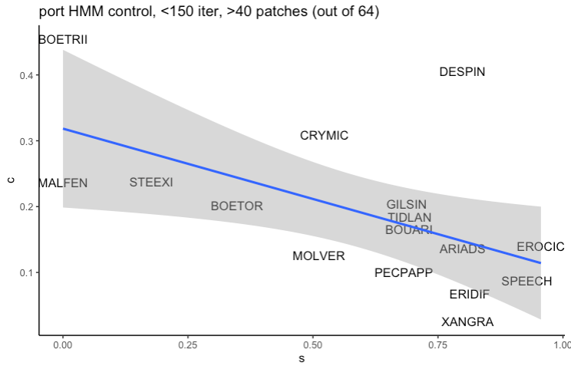
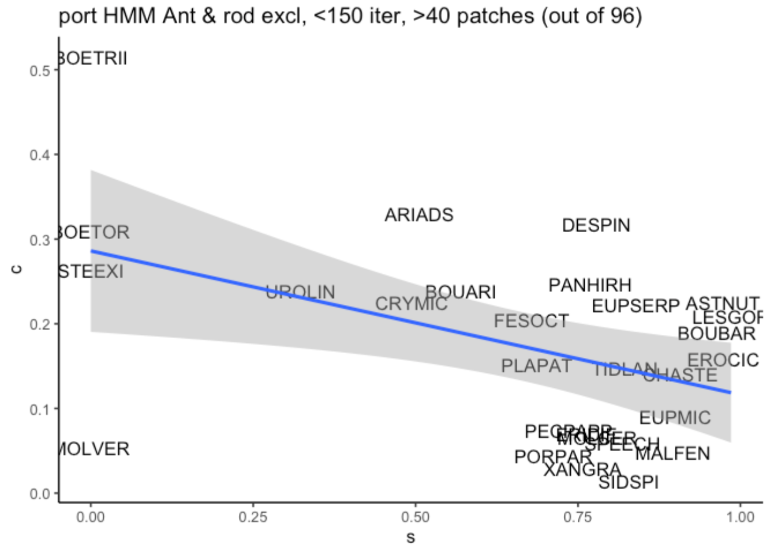
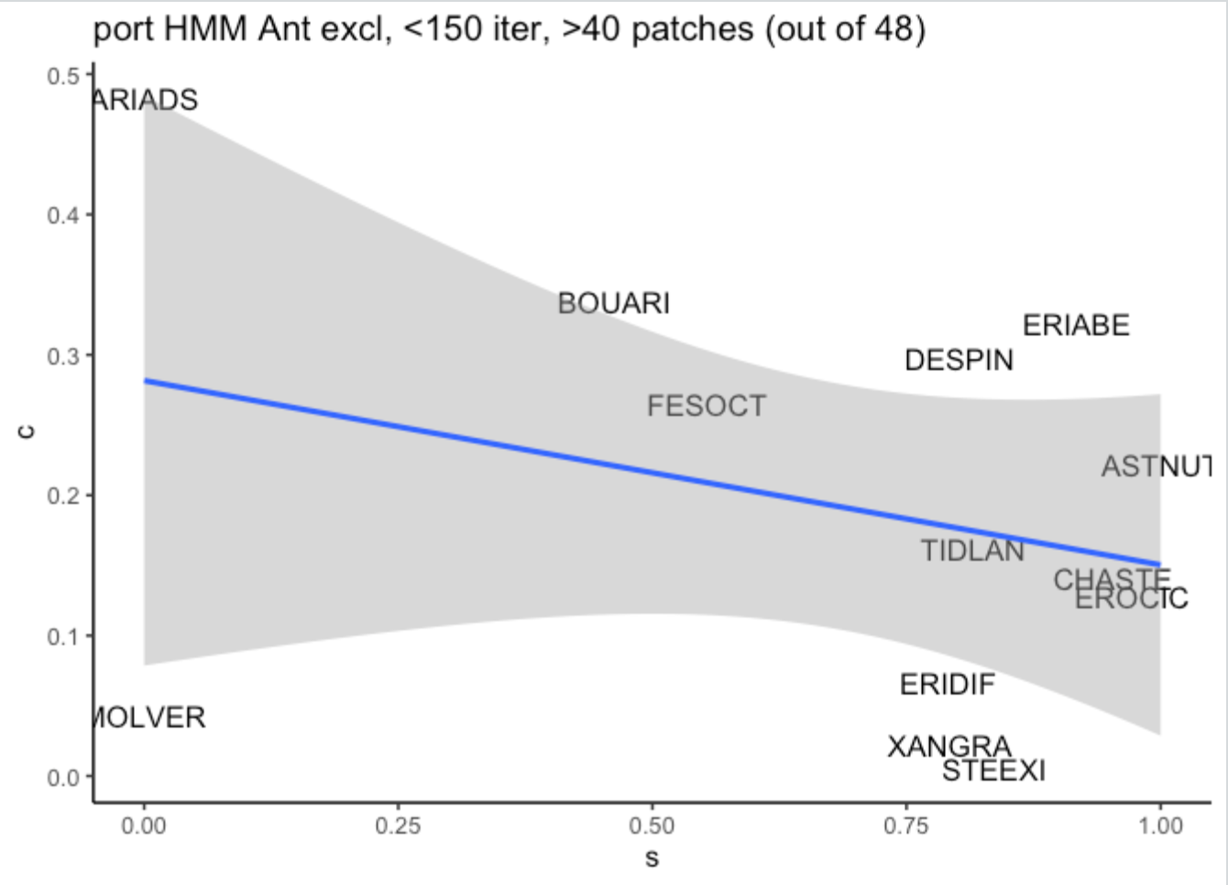

Slide 18
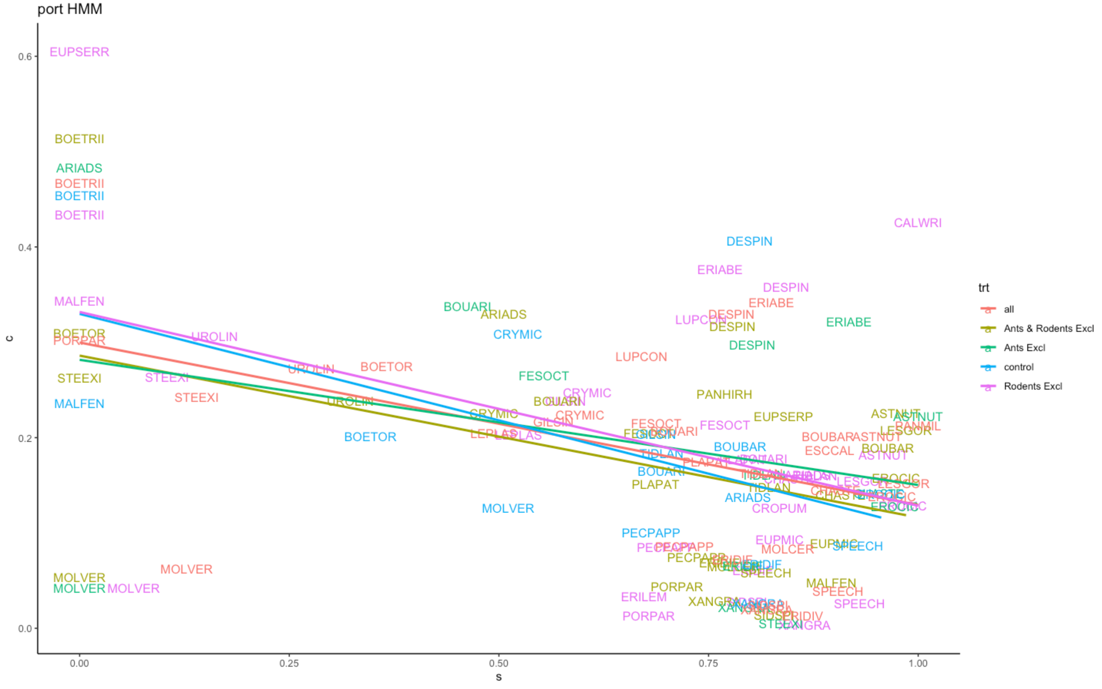

Slide 19
McLaughlin

Slide 20
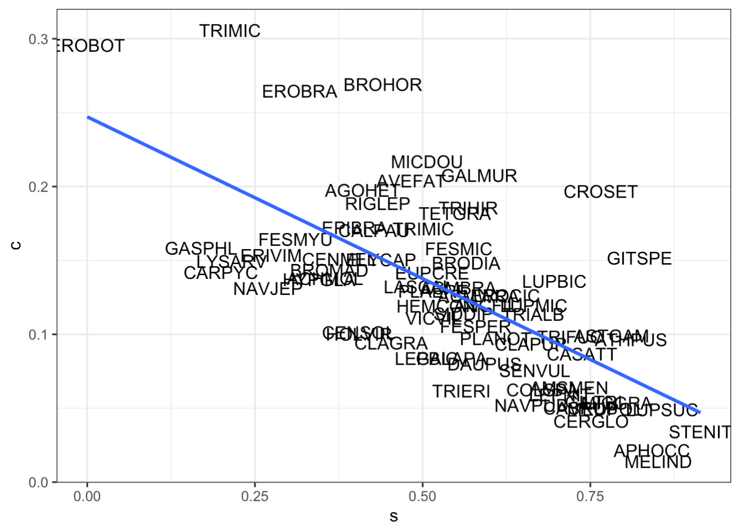
Quadrat

Slide 21
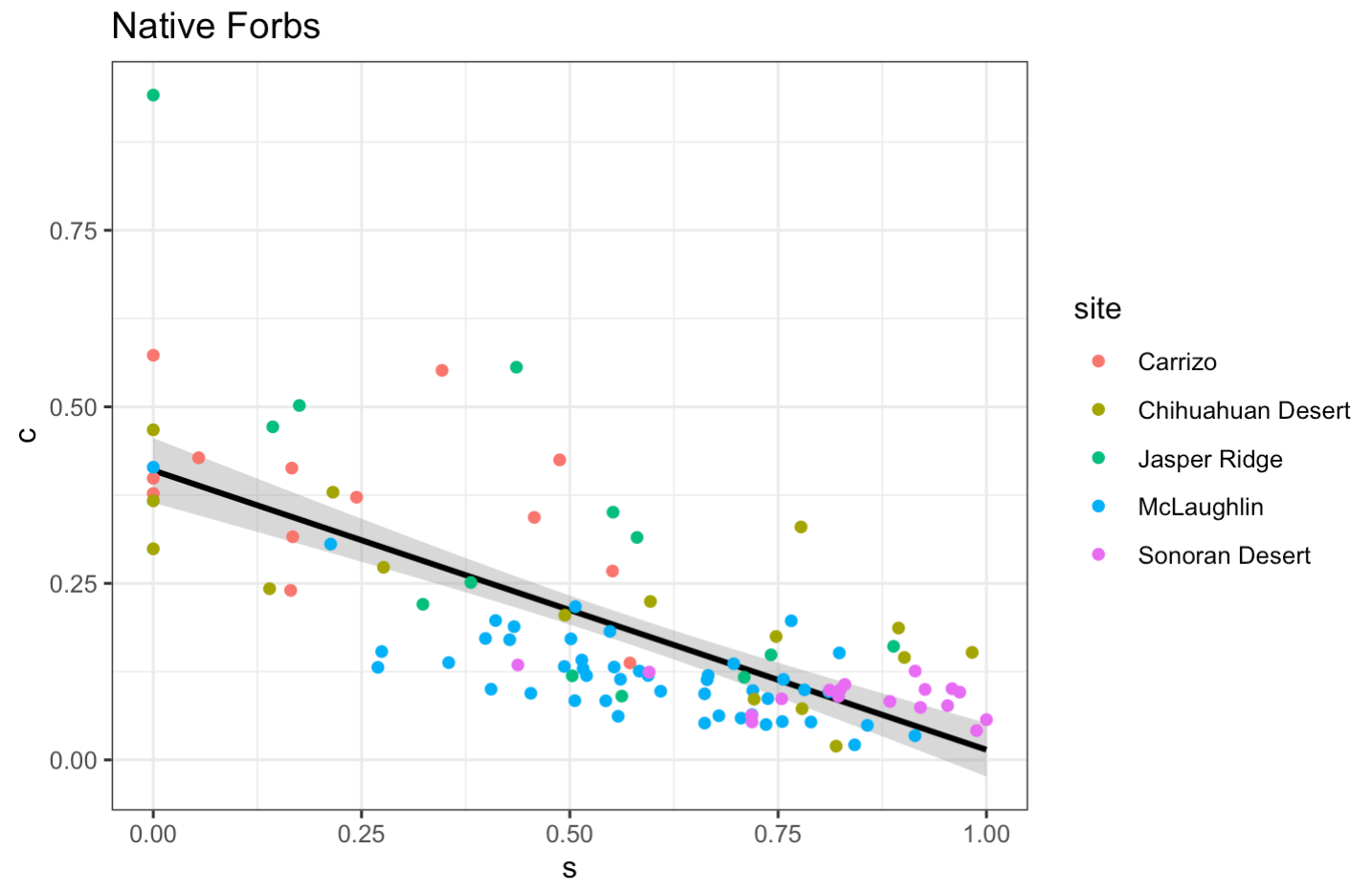
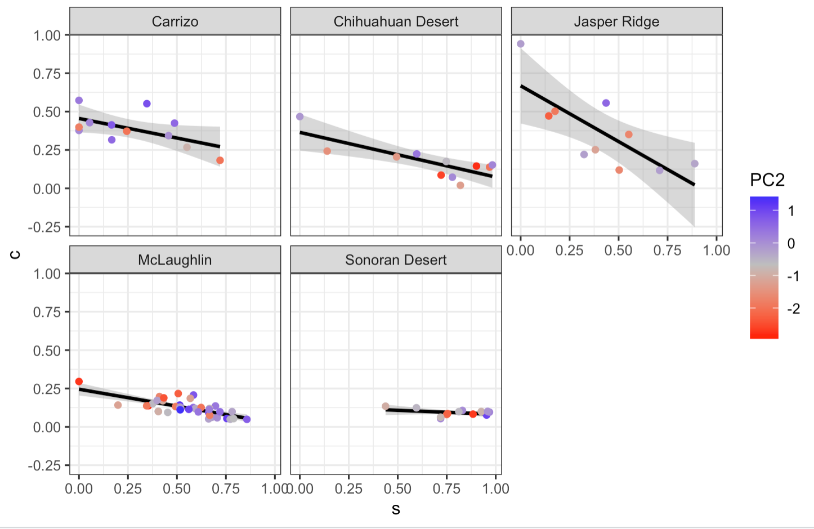
Exploratory graphs – just native forbs
Notes:
PCA used on right is JUST forbs (nat and inv)

